Slide 1



MARKET PLACE TECHNICAL FOUNDATION
Day2
Designed BY ENGR SIR ABDUL REHMAN ANSARI
FRONTEND WEB DEVELOPER/HTML/CSS/JAVA/NEXT.JS/REACT

Slide 2
Step:1
Technology Stack
Framework: Next.js A React-based framework that enables server-side rendering (SSR) and static site generation (SSG), perfect for building high-performance and SEO-friendly applications.
UI Library: shadcn/UI Provides pre-built, customizable UI components that work seamlessly with Tailwind CSS.
Styling Framework: Tailwind CSS A utility-first CSS framework for fast and responsive design.

Slide 3
Step:2
Pages to Create
Home Page
Features: Display promotional banners, featured products, and categories.
Libraries/Features to Use:
shadcn/ui components like Card, Button, and Carousel.
Tailwind CSS for responsive design.

Slide 4
Steps to create page
Step:2
Product Listing Page
shadcn/ui components like Select, Input, and Grid.
Use dynamic routes (pages/products/[category].tsx) for category-based listing.
Product Details Page
shadcn/ui components like Modal, Carousel, and Tabs.
Image optimization using Next.js <Image> component.
Cart Page
shadcn/ui components like Table and Badge.
Persist cart data in localStorage or context.
Checkout Page
shadcn/ui components like Form and Input.
Integrate a payment gateway like Stripe.
Rental Listing Page
Dynamic routes (pages/rentals/[id].tsx) for individual helicopter details.
shadcn/ui components like Card and Filter.
Rental Details Page
shadcn/ui components like Modal and Accordion.
Rental Cart Page
shadcn/ui components for form handling and summary display.

Slide 5
Sanity CMS

Slide 6
Step:3
Schema Design for Data Management
Product Schema

Slide 7
example
export default { name: 'product', type: 'document', fields: [ { name: 'name', type: 'string', title: 'Product Name' }, { name: 'price', type: 'number', title: 'Price' }, { name: 'stock', type: 'number', title: 'Stock Level' }, { name: 'description', type: 'text', title: 'Description' }, { name: 'image', type: 'image', title: 'Product Image' } ]

Slide 8
Step:3
Schema Design for Data Management
Rental Schema

Slide 9
example
export default { name: 'rental', type: 'document', fields: [ { name: 'name', type: 'string', title: ‘Gift Name' }, { name: 'rentalPrice', type: 'number', title: 'Rental Price per Hour' }, { name: 'availability', type: 'boolean', title: 'Availability' }, { name: 'description', type: 'text', title: 'Description' }, { name: 'image', type: 'image', title: ' Image' }, { name: 'rentalTerms', type: 'text', title: 'Rental Terms' } ] };

Slide 10
Step:3
Schema Design for Data Management
Customer Schema

Slide 11
example
export default { name: 'customer', type: 'document', fields: [ { name: 'name', type: 'string', title: 'Customer Name' }, { name: 'email', type: 'string', title: 'Email Address' }, { name: 'address', type: 'string', title: 'Shipping Address' } ] };

Slide 12
Step:3
Schema Design for Data Management
Order Schema

Slide 13
example
export default { name: 'order', type: 'document', fields: [ { name: 'customer', type: 'reference', to: [{ type: 'customer' }], title: 'Customer' }, { name: 'products', type: 'array', of: [{ type: 'reference', to: [{ type: 'product' }] }], title: 'Products' }, { name: 'total', type: 'number', title: 'Total Amount' }, { name: 'status', type: 'string', title: 'Order Status' } ] };

Slide 14
Step:3
Schema Design for Data Management
Rental Order Schema

Slide 15
example
export default { name: 'rentalOrder', type: 'document', fields: [ { name: 'customer', type: 'reference', to: [{ type: 'customer' }], title: 'Customer' }, { name: ‘gift', type: 'reference', to: [{ type: 'rental' }], title: ‘Gift' }, { name: 'rentalDuration', type: 'number', title: 'Rental Duration (Hours)' }, { name: 'total', type: 'number', title: 'Total Amount' }, { name: 'status', type: 'string', title: 'Rental Order Status' } ] };

Slide 16
Step:4
Third-Party APIs
Requirements

Slide 17
example
Payment Gateway API: For secure transaction processing.
Shipment Tracking API: To provide real-time shipment updates.
Email Notification API: For sending order confirmations.
Booking Availability API: To check gift rental availability.

Slide 18
Step:5
System Architecture Design
Diagram

Slide 19
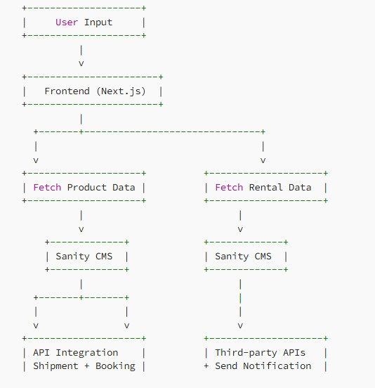

Slide 20
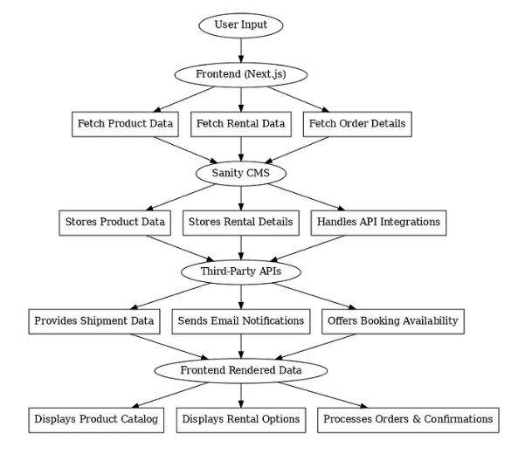

Slide 21
Step:6
API Endpoints Plan
Planning

Slide 22
Route
/products (GET)
Description: Fetch all product details.
Response Example:
GO

Slide 23
Examples
[ { "id": "1", "name": “gift item", "price": 20.0, "stock": 50 } ]
To be continue

Slide 24
Route
/rentals (GET)
Description: Fetch all available rental gift items.
Response Example:
GO

Slide 25
Examples
[ { "id": "1", "name": "Giftitem A", "rentalPrice": 1000, "availability": true } ]
To be continue

Slide 26
Route
/orders (POST)
Description: Save new order details.
Request Example:
GO

Slide 27
Examples
{ "customerId": “786", "products": ["1", "2"], "total":90.0, }
To be continue

Slide 28
Route
/rentalOrders (POST)
Description: Save new rental booking details.
Request Example:
GO

Slide 29
Examples
{ "orderId": "123", "status": "In Transit" }
{ "customerId": “786", “giftitemId": "1", "rentalDuration": 5, "total": 2500 }
To be continue

Slide 30
Route
/shipment (GET)
Description: Fetch the shipment status for an order.
Response Example:
GO

Slide 31
Examples
{{ "orderId": "123", "status": "In Transit" }
To be continue

Slide 32









Thank you so much
For watching my repo
Contact:+923100273708(official)
https://github.com/rehman2017
abdulrehman201717@gmail.com
abdulrehman20172024@gmail.com
abdulrehman2024@outlook.com
Connected with
Engr Sir Abdul Rehman Ansari(official web developer working at the Academy School near Zia Uddin hospital main campus)

Slide 33




Special Thanx To

Slide 34
Allah Hafiz
Take care of yourselves

